Slide 1


Data Science vs. AI vs. Machine Learning: Untangling the Terms
This presentation will demystify the relationships and overlaps between data science, AI, and machine learning. We will explore their synergy in real-world applications and consider the ethical implications.
by nithyalakshmi M

Slide 2

Data Science: The Big Picture
1
Definition
2
Process
An interdisciplinary field extracting knowledge from complex data.
Involves question formulation, data preparation, and thorough analysis.
3
Tools
4
Outcome
Leverages statistics, programming, and domain expertise.
Generates actionable insights for informed decisions.

Slide 3





Machine Learning: The Predictive Engine
Definition
Algorithms that learn from data without explicit programming.
Role
Serves as the predictive engine within data science.
Goal
Creates models to forecast future outcomes.
Example
Predicting customer churn based on past behavior.

Slide 4

Artificial Intelligence: Decision-Making and Autonomy
Definition
Powered by ML
Creating systems that mimic human intelligence.
Machine Learning provides the core functionality for AI.
Broader Scope
Goal
Includes NLP, computer vision, and robotics.
Develop autonomous systems capable of decision-making.

Slide 5
The Relationship: A Venn Diagram
Data Science
Artificial Intelligence
Machine Learning
The overarching field
Mimics human intelligence
Subset of AI
Encompasses AI and ML
Powered by ML
Predictive capabilities
The "glue" of intelligent systems
Broader decision-making systems
Learns from data patterns

Slide 6
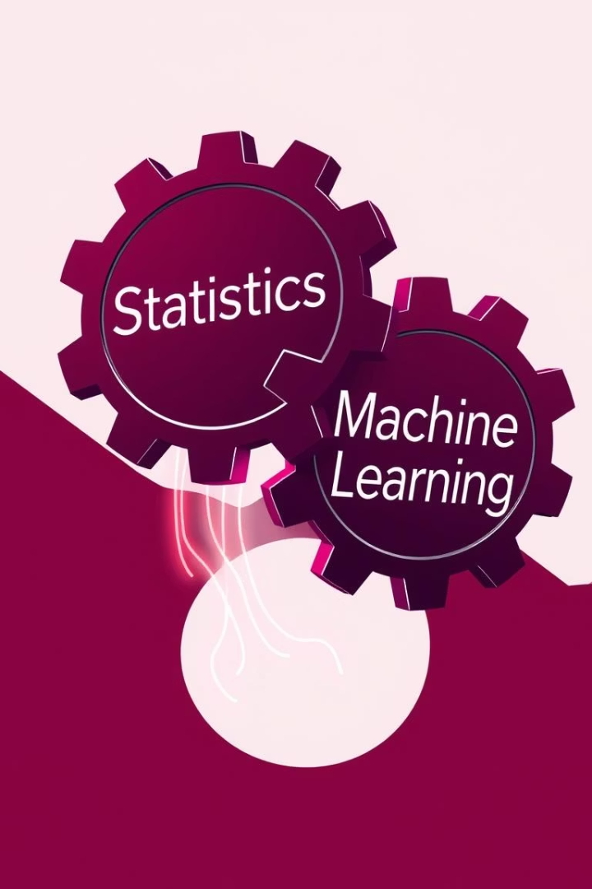
Statistics vs. Machine Learning: Choosing the Right Tool
1
Statistics
Hypothesis testing, causal inference, and understanding relationships.
2
Machine Learning
Prediction, pattern recognition, and complex data handling.
3
Rule of Thumb
Use statistics for explanation; use ML for prediction.
4
Example
A/B testing (stats) versus image recognition (ML).

Slide 7




Real-World Synergy: Examples in Action
Recommendation Engines
Data Science identifies preferences, ML predicts content. Netflix: 80% shows watched are from recommendations.
Supply Chain Optimization
Data Science analyzes demand, ML forecasts future needs. Reduces costs by 15-20% (McKinsey).
Fraud Detection
Data Science identifies suspicious transactions, ML flags potentially fraudulent activity.

Slide 8








Ethics & Bias: A Shared Responsibility
Perpetuate Biases
Fairness & Transparency
Models can unintentionally reflect existing societal biases.
Crucial for responsible development and deployment of models.
Example
Mitigation Strategies
Bias in facial recognition often shows gender and race disparities.
Diverse datasets, algorithmic audits, and clear ethical guidelines.

